Slide 1
UART Design Using Verilog for FPGA Implementation
Bangladesh University of Engineering and Technology
Department of Electrical and Electronic Engineering
Final Project Presentation eee 304_B1
Date: 03/12/2024
Presented by: Group 05
Ilias Ahmad (2006068)
Puspita Mobarak (2006087)
Md. Al Amin (2006088)
Mohammad Al Hosan (2006090)
Dipto Archishman Saha (2006093)
Instructors:
1. Nafis Sadik
Lecturer, Dept of EEE
BUET
2. H.M. Tahmeed-Ul-Islam
Lecturer(PT), Dept of EEE
BUET

Slide 2
Overview
Objective
Introduction
State Diagram
Simulation
Timing Diagram and Pin Planner
Hardware Demonstration
Testbench
Credits and References
EEE 304 Group_No: B1_05

Slide 3
Objective
Development of Verilog modules for UART Transmitter and Receiver
Hardware implementation of modules using FPGA
Evaluation of the functionality of modules using timing diagram and testbench
EEE 304 Group_No: B1_05

Slide 4
Introduction
UART (Universal Asynchronous Receiver/Transmitter) is a physical circuit in a microcontroller or a standalone IC, whose purpose is to transmit and receive serial data.
Transmitting UART (Tx) converts parallel data to serial, transmits it in serial to receiving UART (Rx), which then converts the serial data back to parallel.
Baud Rate – Specific frequency at which receiving UART reads the incoming bits. It is a measure of the speed of data transfer, expressed in bits per second. Both UARTs must operate at the same baud rate. It is determined by baud rate generator.
EEE 304 Group_No: B1_05

Slide 5
Introduction
Asynchronous data transmission – No clock signal to synchronize output of bits from transmitting UART to the sampling of bits by receiving UART.
Instead, transmitting UART adds start and stop bits to the data packet/frame being transferred. Can be simplex, half-duplex or full-duplex.
A data packet consists of – 1 start bit (low), 8 data bits, and 2 stop bits (high).
EEE 304 Group_No: B1_05

Slide 6
Introduction
Finite State Machine (FSM) – A sequential circuit having a limited (finite) number of states, where the machine can be in exactly one state at a time.
The machine can change from one state to another in response to inputs, this change is called transition and the number of states are called modulus.
FSM consists of state register and combinational logic.
State Diagram – A directed graph where the nodes represent internal states and the arrows represent state transitions.
EEE 304 Group_No: B1_05

Slide 7
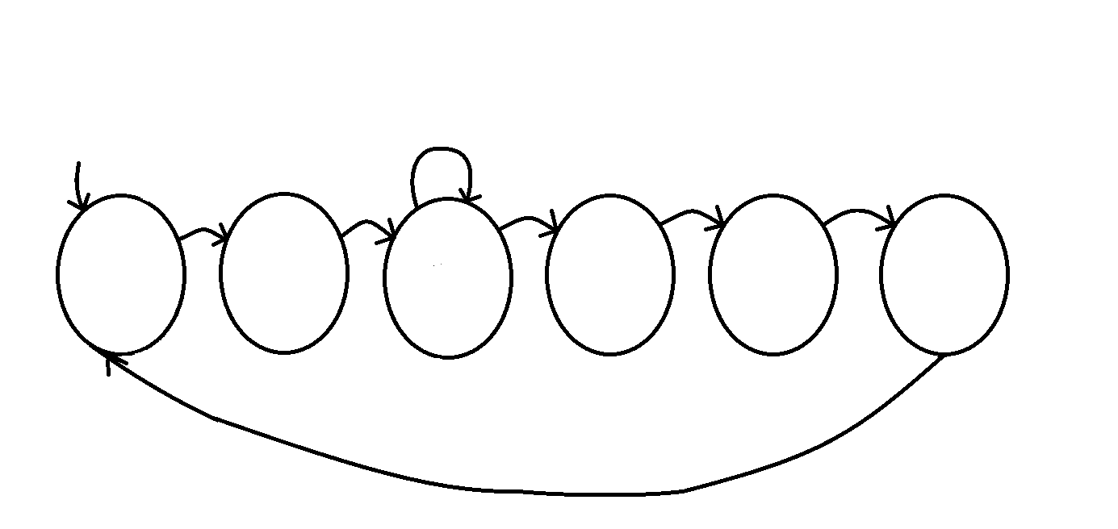
State Diagram
i < 8
i_Tx_Dv
1
1
1
1
i == 8
S0
S1
S2
S3
S4
S5
L_{A} = 1
L_{B} = 0
L_{C} = 0
L_{A} = 0
L_{B} = 1
L_{C} = 0
L_{A} = b[i]
L_{B} = 1
L_{C} = 0
L_{A} = par
L_{B} = 1
L_{C} = 0
L_{A} = 1
L_{B} = 0
L_{C} = 1
L_{A} = 1
L_{B} = 0
L_{C} = 1
1
EEE 304 Group_No: B1_05

Slide 8
Simulation
Transmitter code: https://www.edaplayground.com/x/mHVa
Receiver code: https://www.edaplayground.com/x/UYMc
EEE 304 Group_No: B1_05

Slide 9
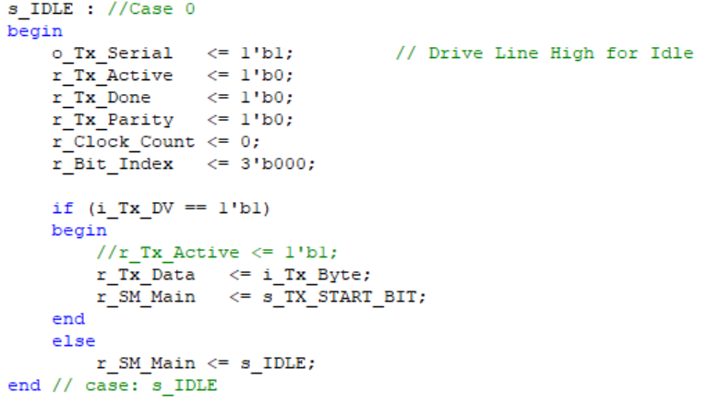
Simulation - Transmitter
Case: Idle
EEE 304 Group_No: B1_05

Slide 10
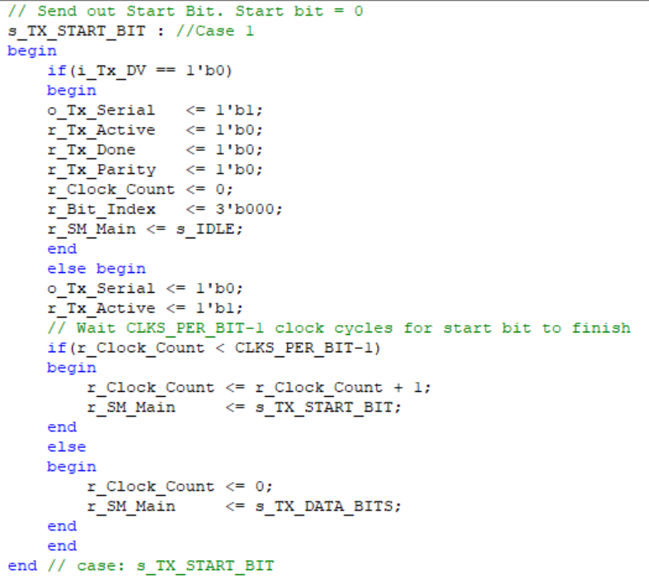
Simulation - Transmitter
Case: Start Bit
EEE 304 Group_No: B1_05

Slide 11
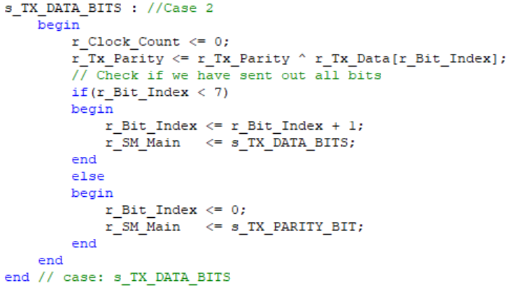
Simulation - Transmitter
Case: Data Bits
EEE 304 Group_No: B1_05

Slide 12
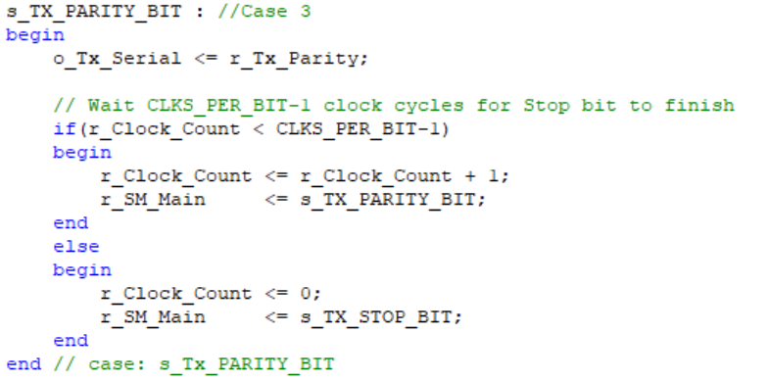
Simulation - Transmitter
Case: Parity Bit
EEE 304 Group_No: B1_05

Slide 13
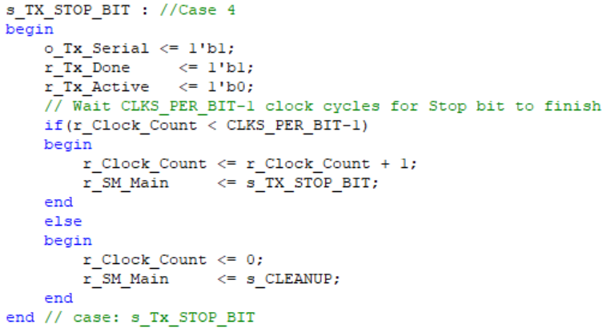
Simulation - Transmitter
Case: Stop Bit
EEE 304 Group_No: B1_05

Slide 14
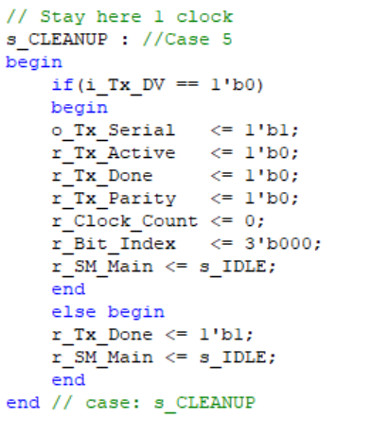
Simulation - Transmitter
Case: Cleanup
EEE 304 Group_No: B1_05

Slide 15
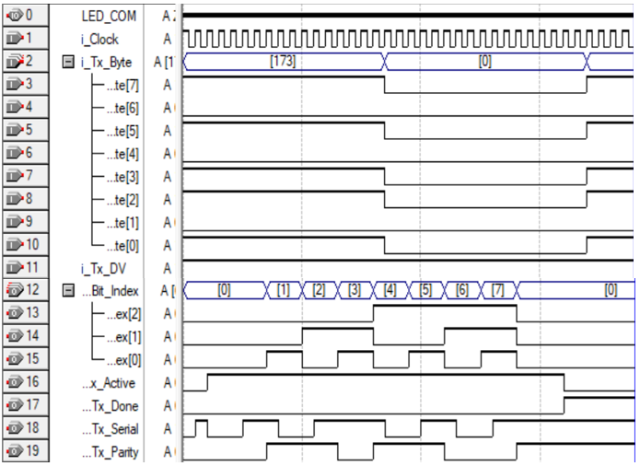
Timing Diagram - Transmitter
Bit Sequence:
10101101
EEE 304 Group_No: B1_05

Slide 16
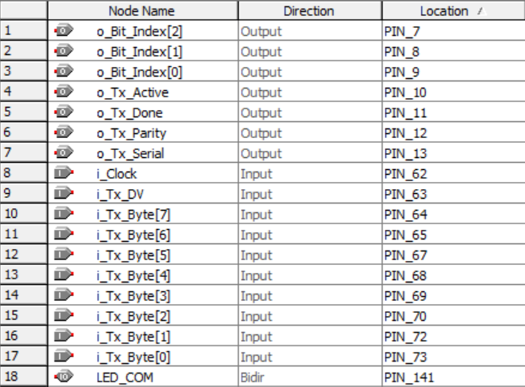
Pin Planner - Transmitter
EEE 304 Group_No: B1_05

Slide 17
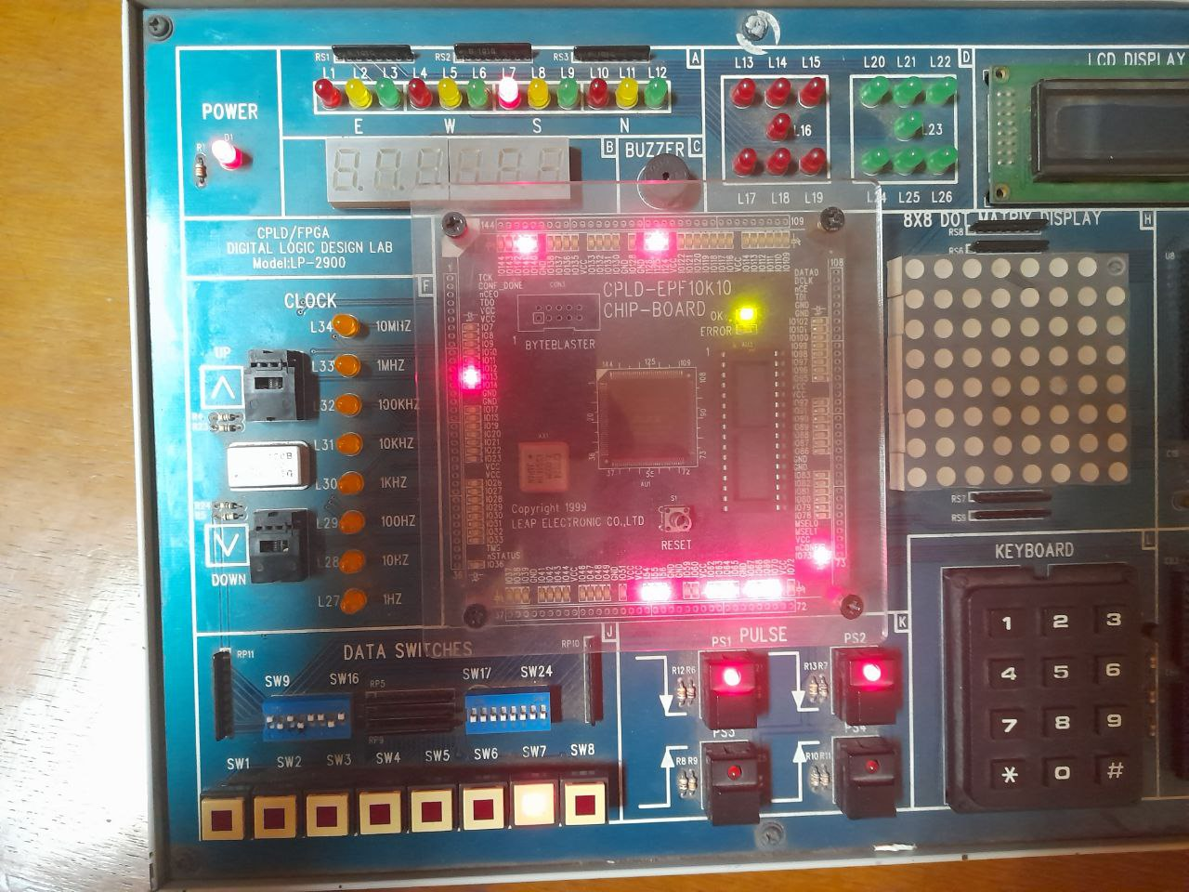
Transmitter Output
Idle (1)

Slide 18
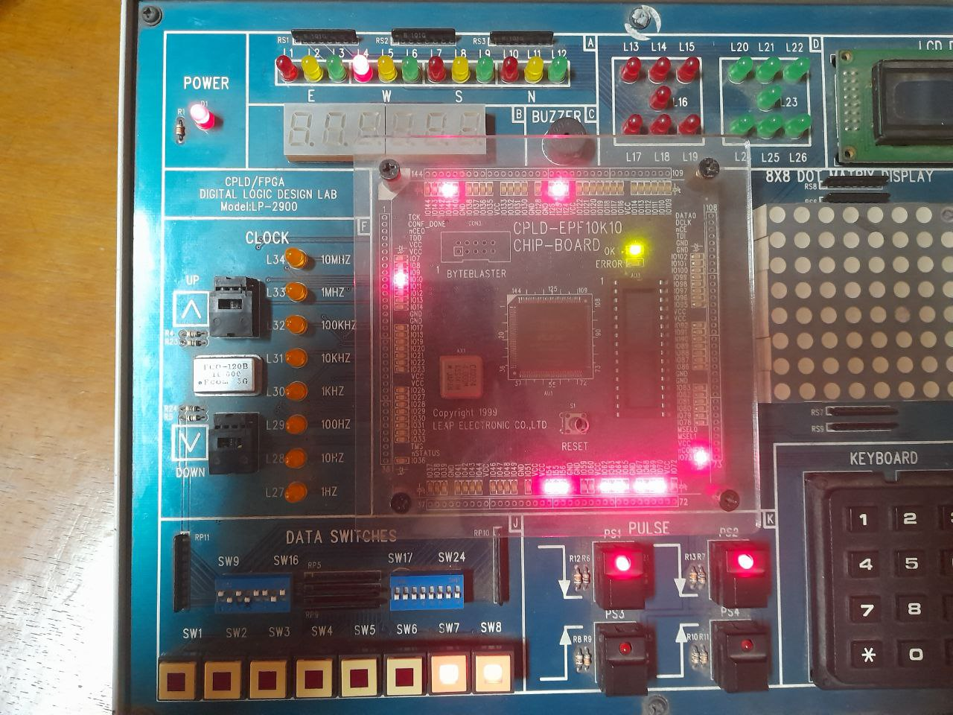
Transmitter Output
Start (0)
Send 10101101

Slide 19
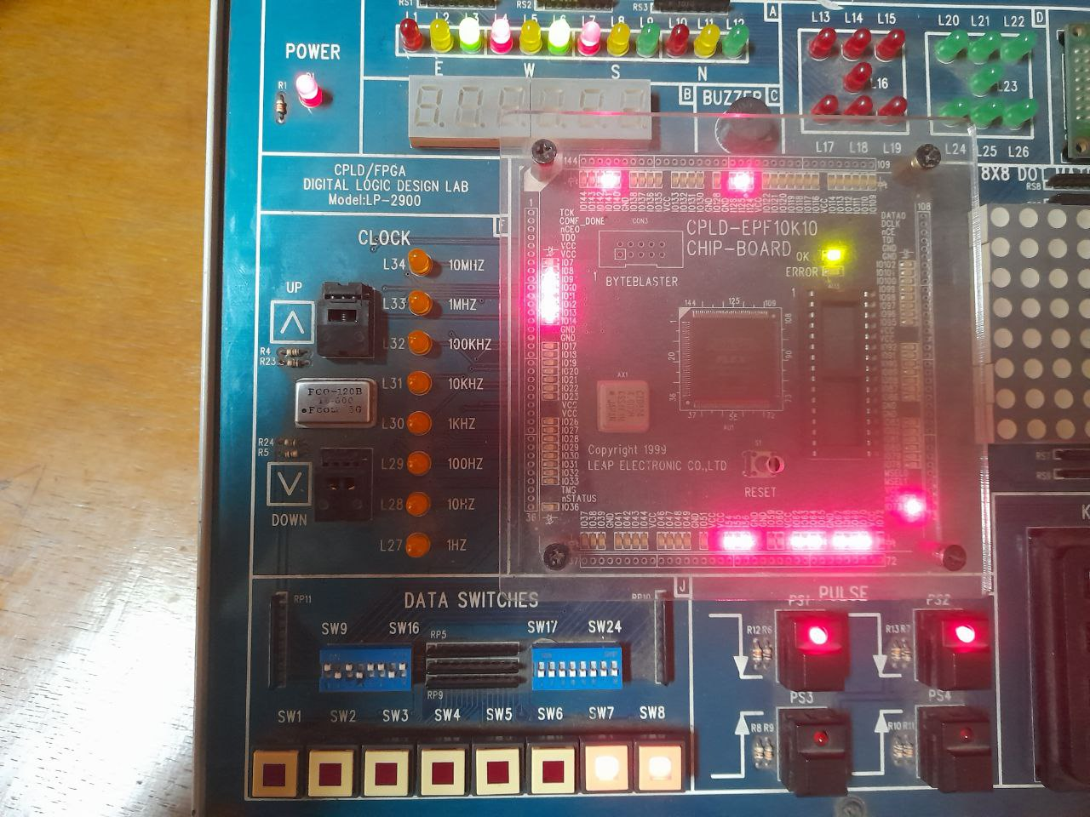
Transmitter Output
Bit 1 (1)

Slide 20
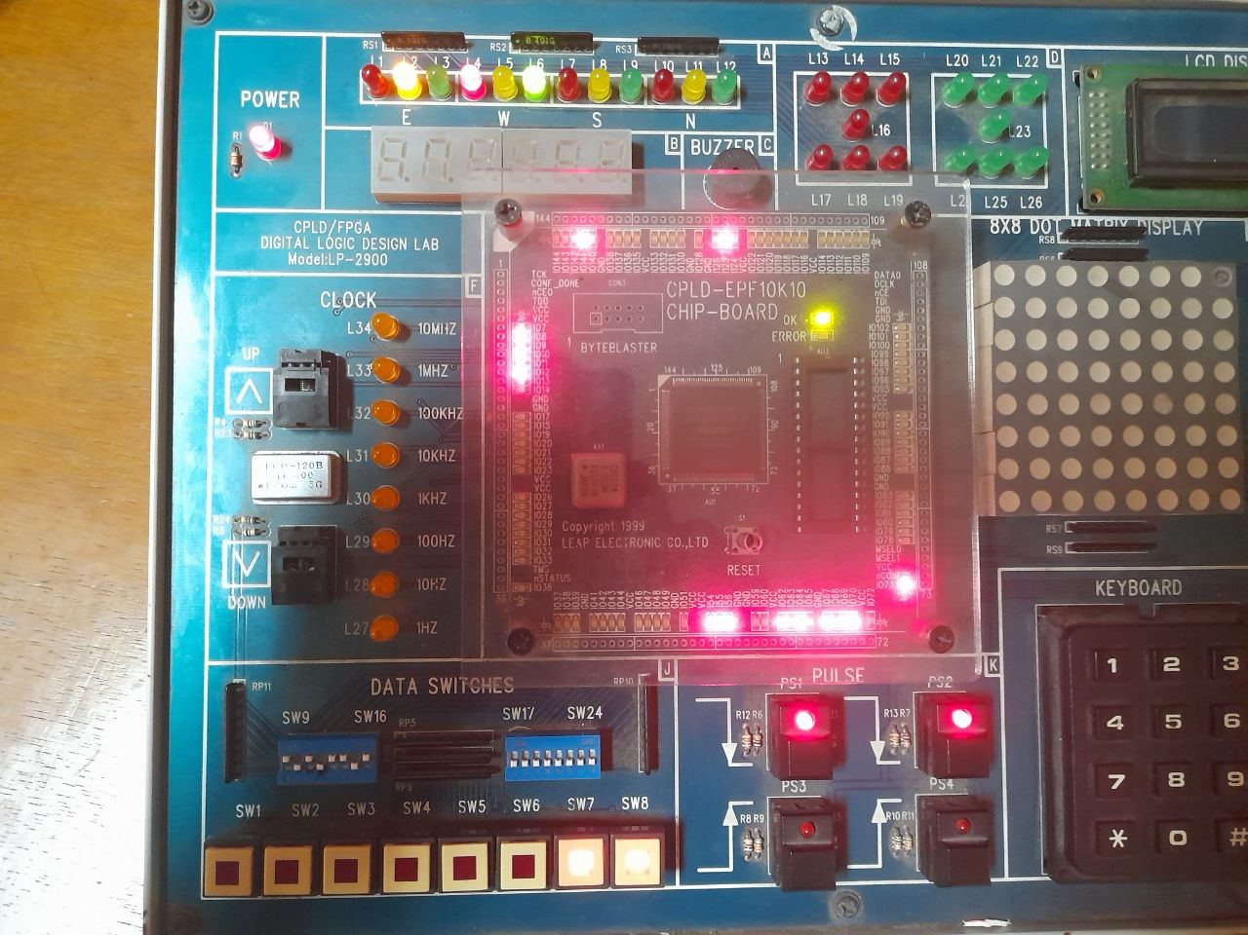
Transmitter Output
Bit 2 (0)

Slide 21
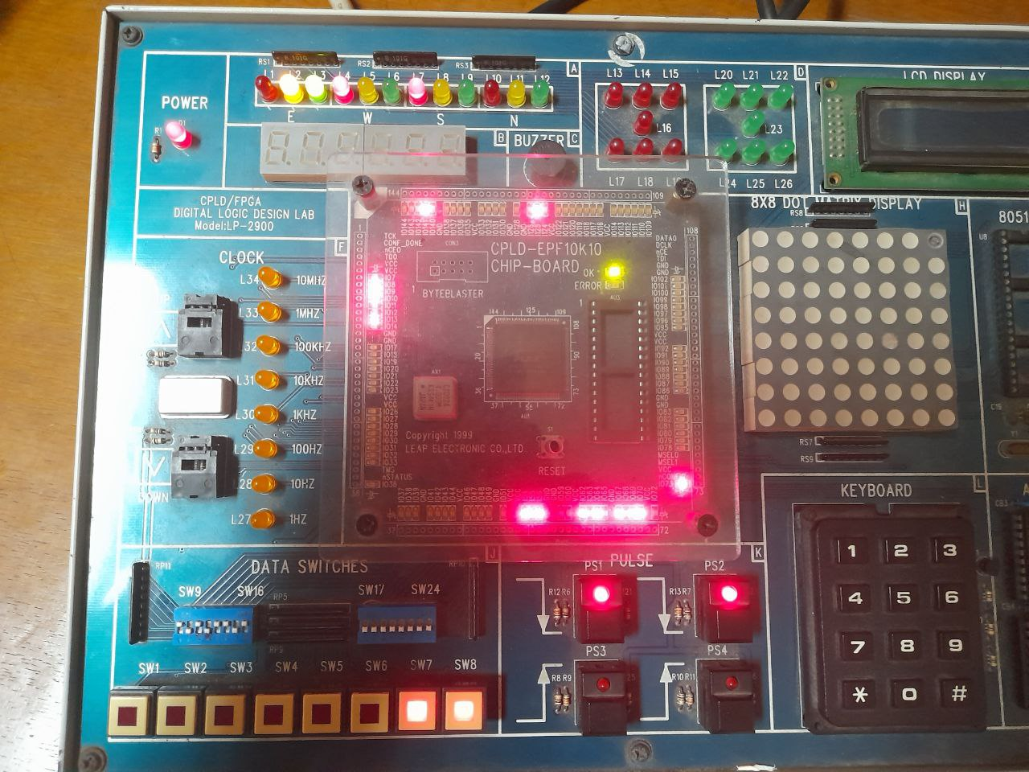
Transmitter Output
Bit 3 (1)

Slide 22
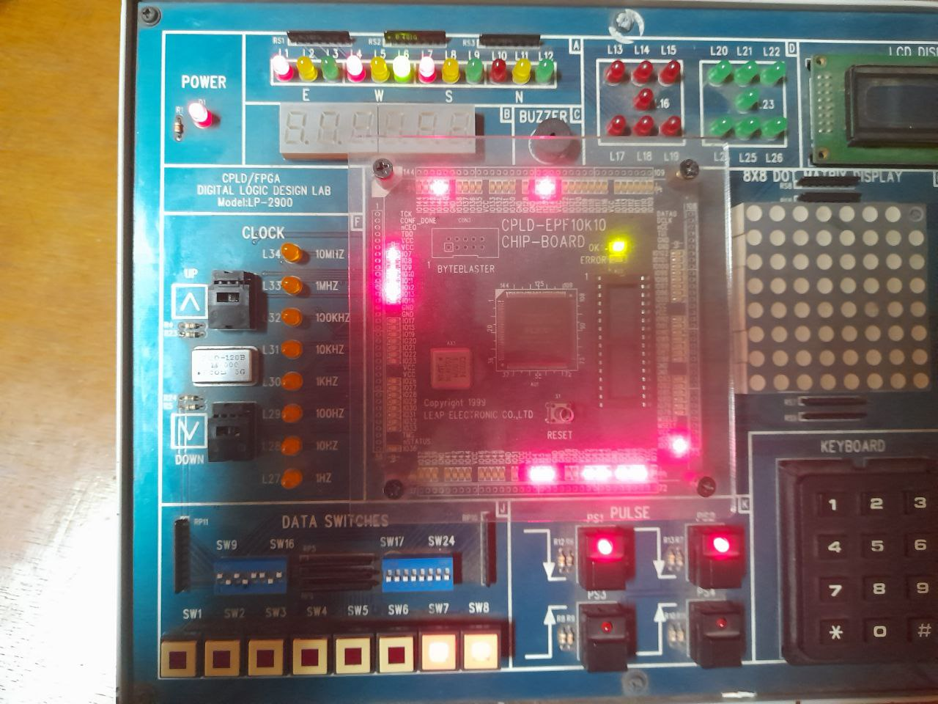
Transmitter Output
Bit 4 (1)

Slide 23
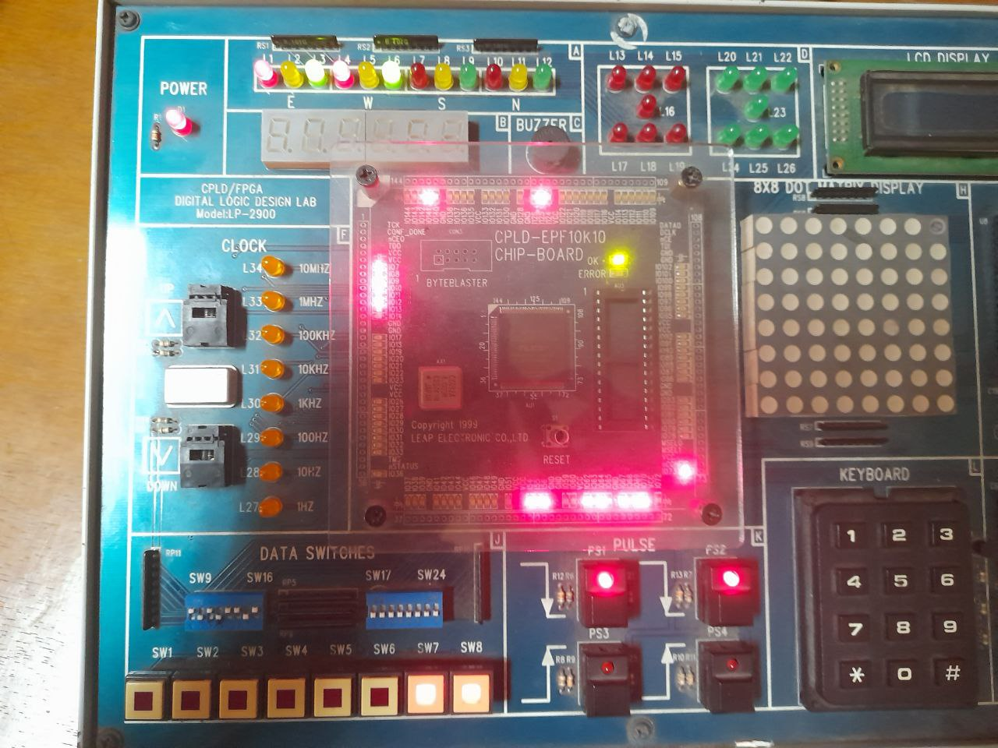
Transmitter Output
Bit 5 (0)

Slide 24
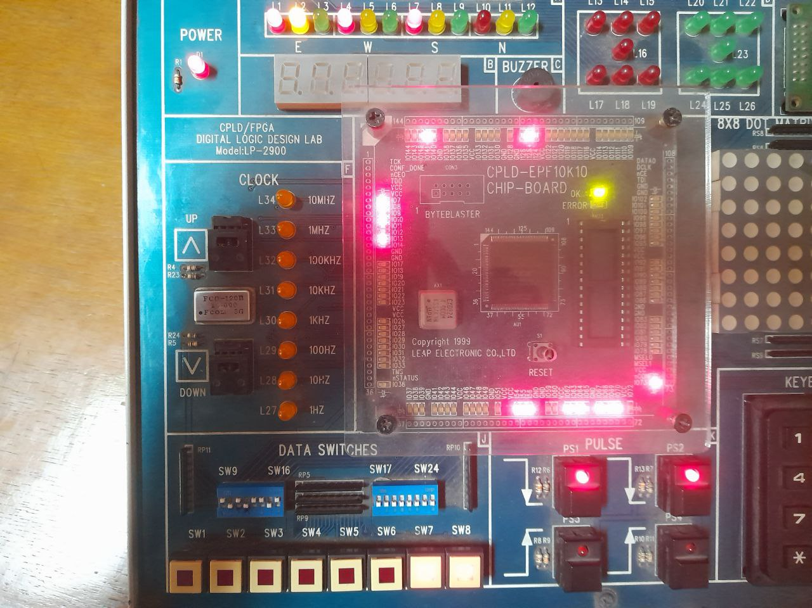
Transmitter Output
Bit 6 (1)

Slide 25
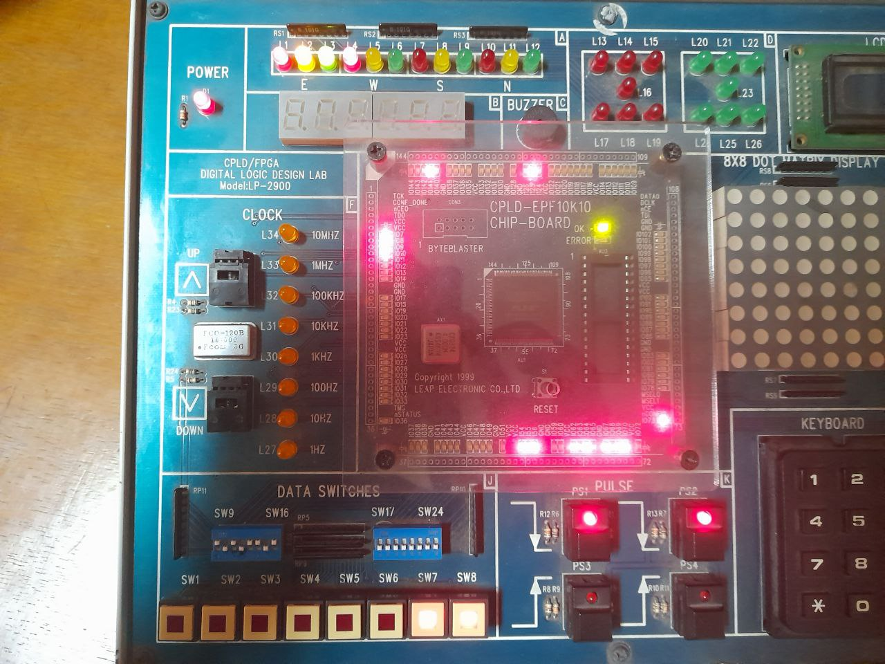
Transmitter Output
Bit 7 (0)

Slide 26
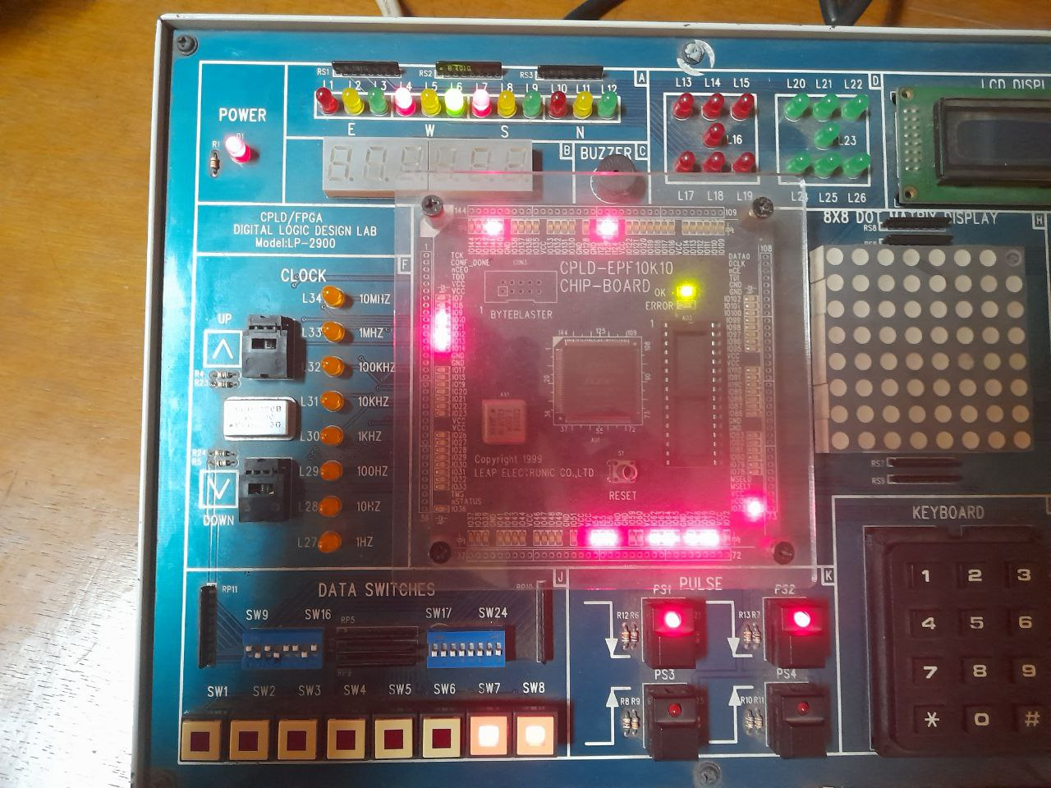
Transmitter Output
Bit 8 (1)
Sent Bit: 10101101

Slide 27
Transmitter Output
Parity Bit (1)
Odd Parity

Slide 28
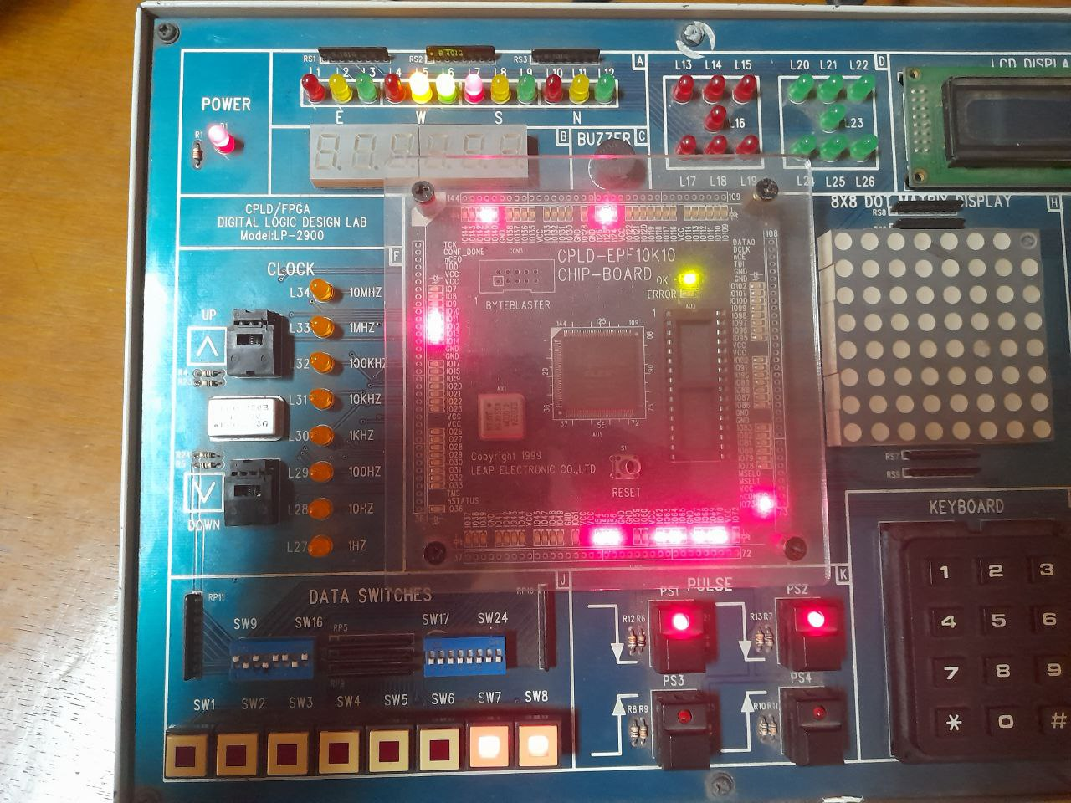
Transmitter Output
Stop Bit (1)

Slide 29
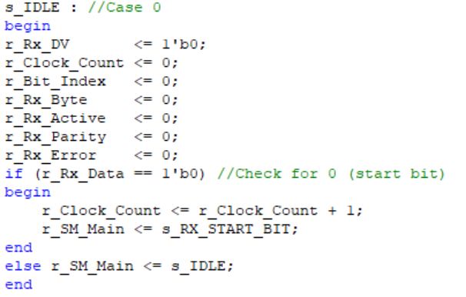
Simulation - Receiver
Case: Idle
EEE 304 Group_No: B1_05

Slide 30
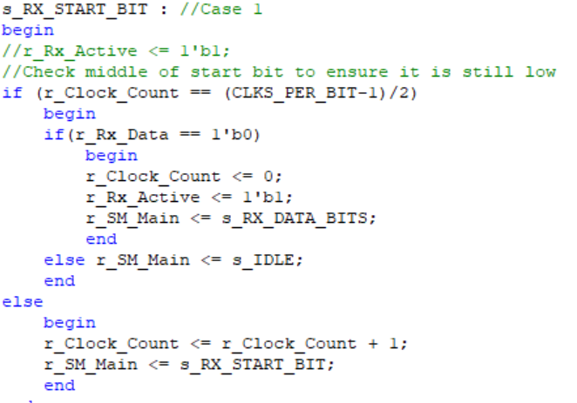
Simulation - Receiver
Case: Start Bit
EEE 304 Group_No: B1_05

Slide 31
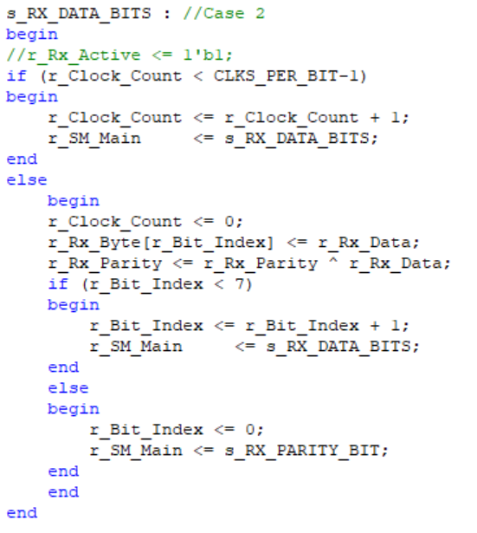
Simulation - Receiver
Case: Data Bits
EEE 304 Group_No: B1_05

Slide 32
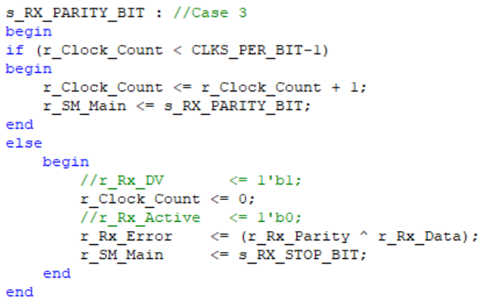
Simulation - Receiver
Case: Parity/Error Bit
EEE 304 Group_No: B1_05

Slide 33
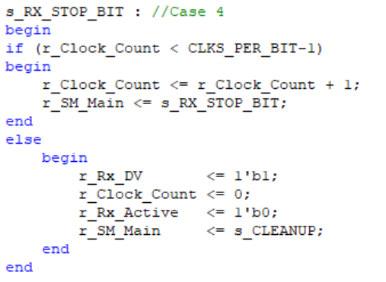
Simulation - Receiver
Case: Stop Bit
EEE 304 Group_No: B1_05

Slide 34
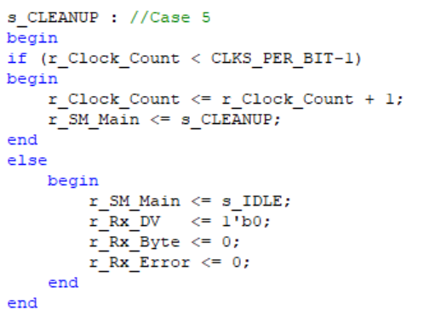
Simulation - Receiver
Case: Cleanup
EEE 304 Group_No: B1_05

Slide 35
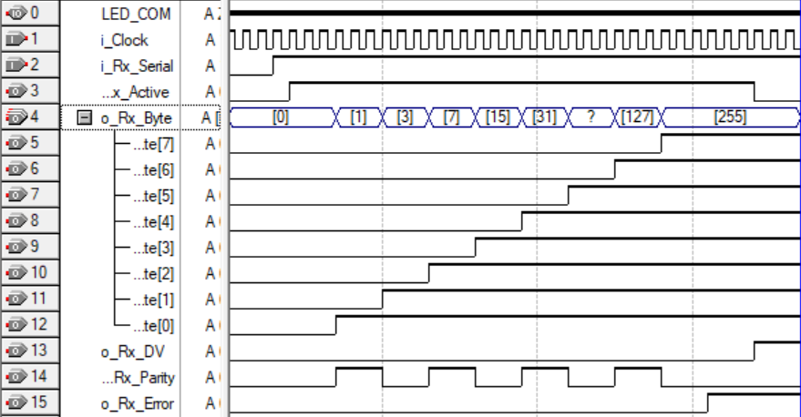
Timing Diagram - Receiver
Bit Sequence:
11111111
EEE 304 Group_No: B1_05

Slide 36
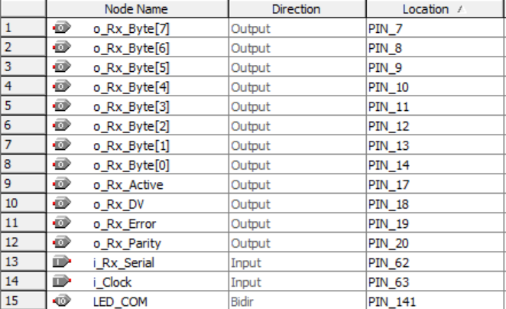
Pin Planner - Receiver
EEE 304 Group_No: B1_05

Slide 37
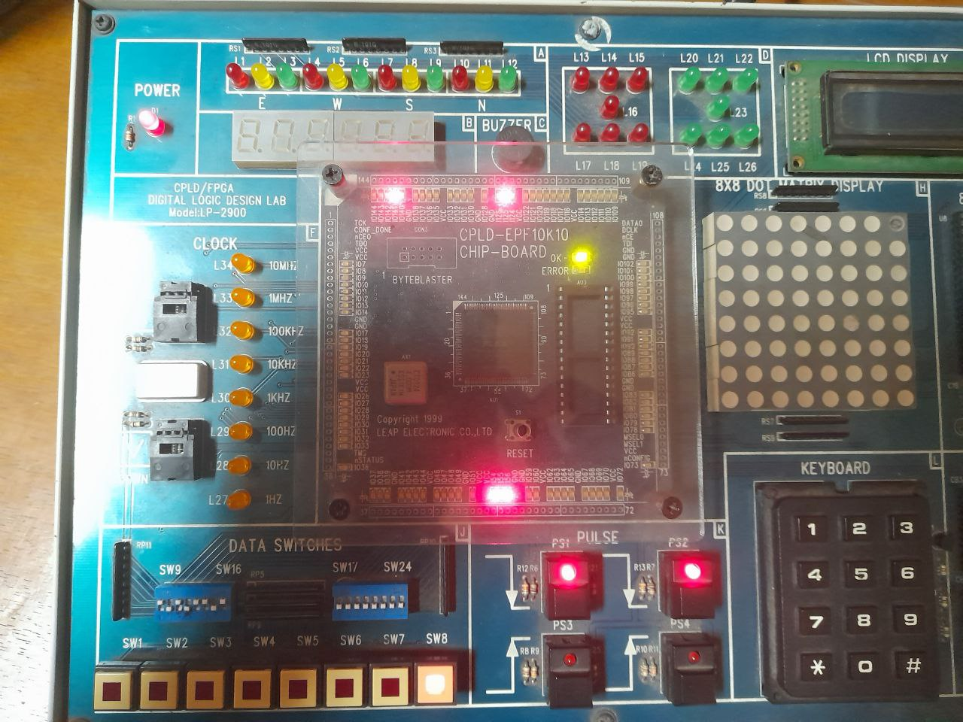
Receiver Output
Channel Inactive
Receive Start Bit (0)
Then Active

Slide 38
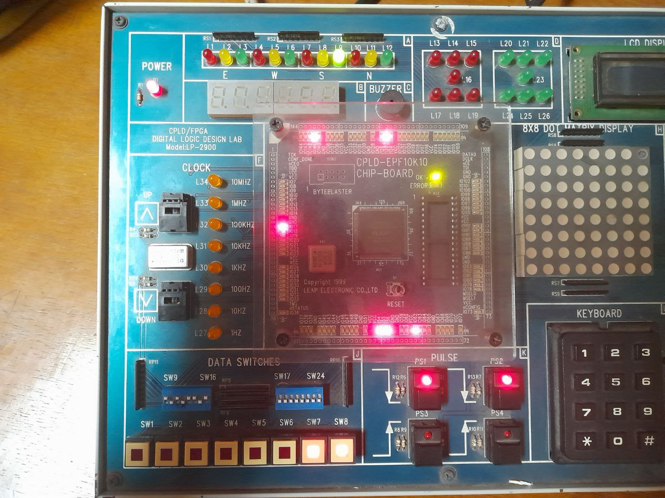
Receiver Output
Channel Active
Receive 11111111

Slide 39
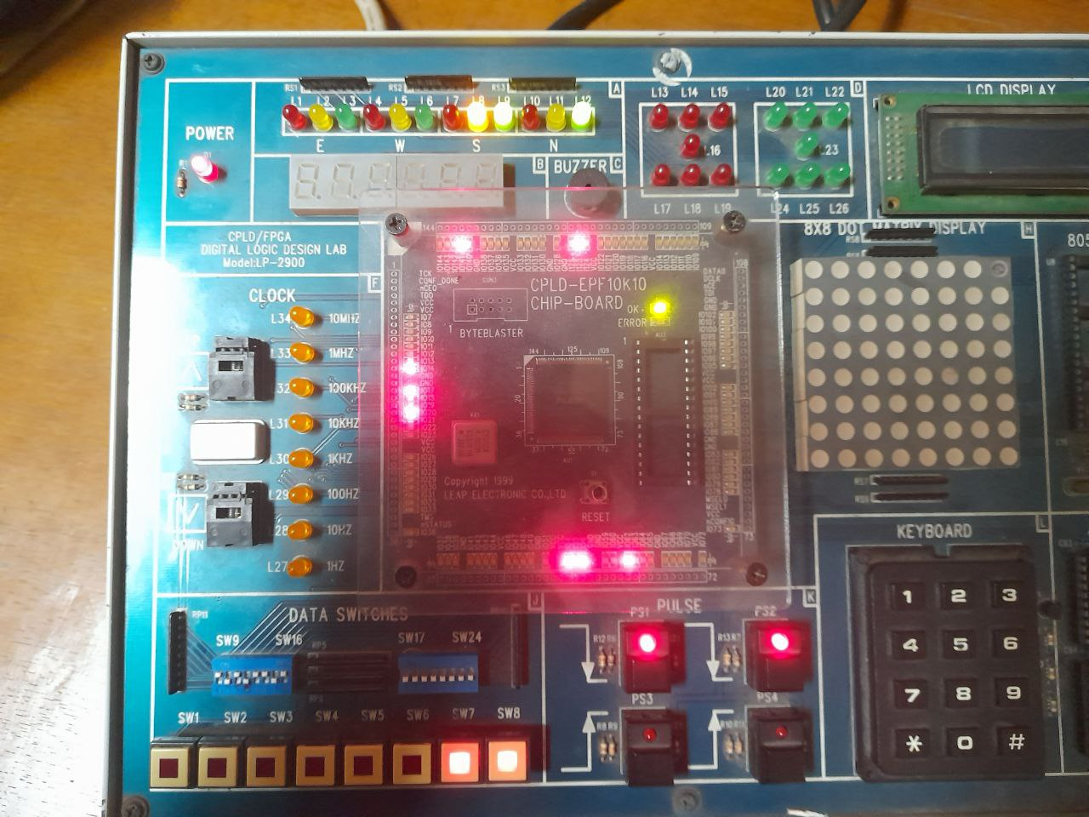
Receiver Output
Bit 1 (1)

Slide 40
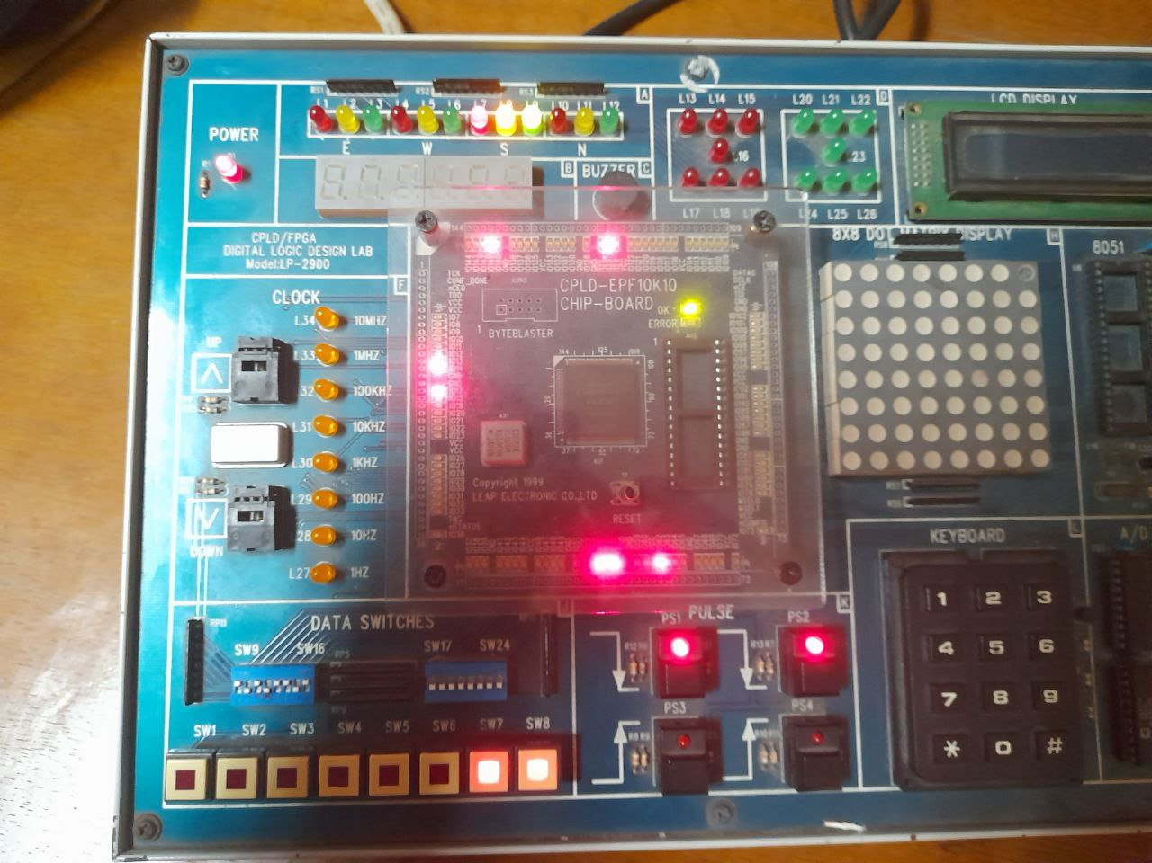
Receiver Output
Bit 2 (1)

Slide 41
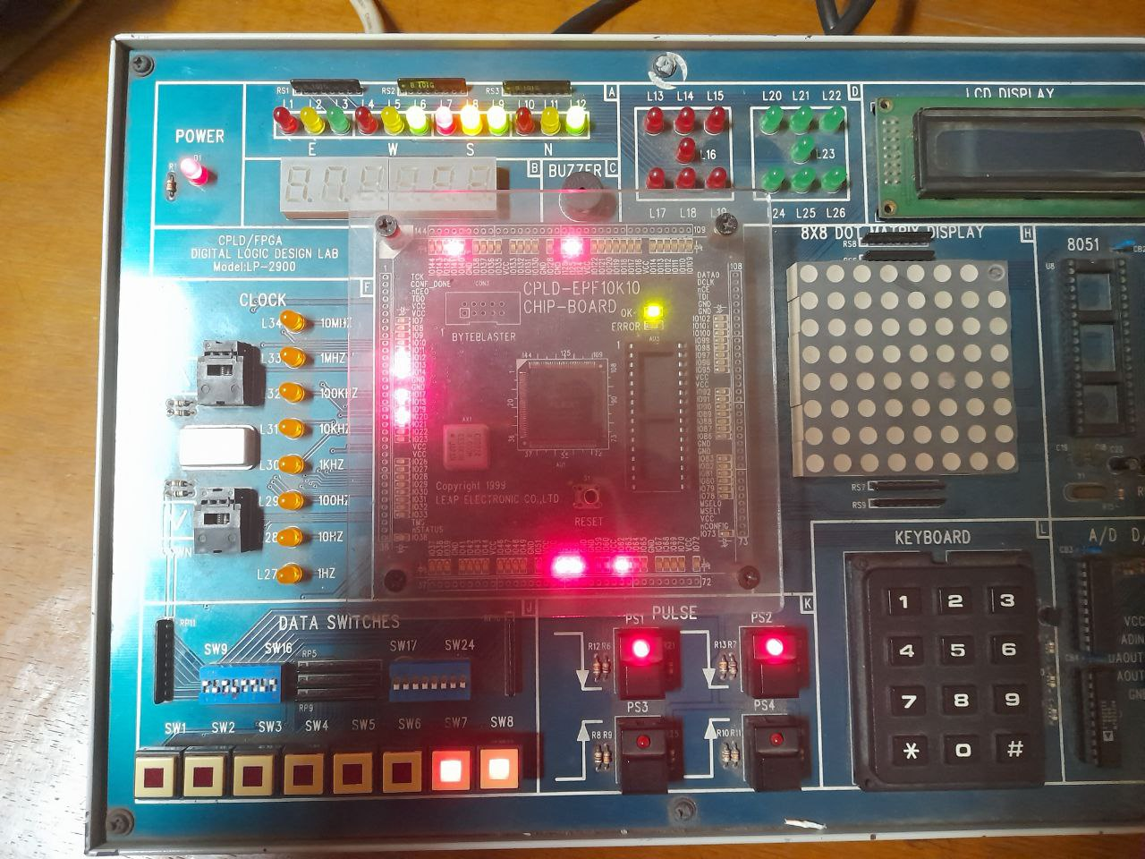
Receiver Output
Bit 3 (1)

Slide 42
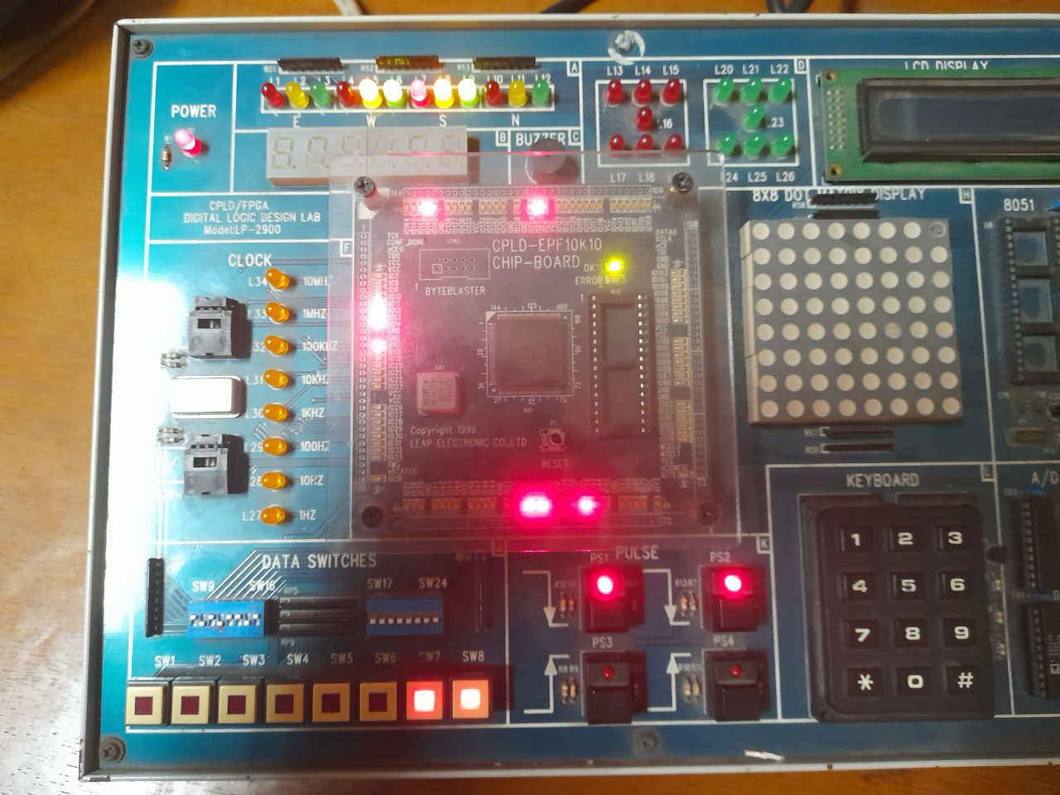
Receiver Output
Bit 4 (1)

Slide 43
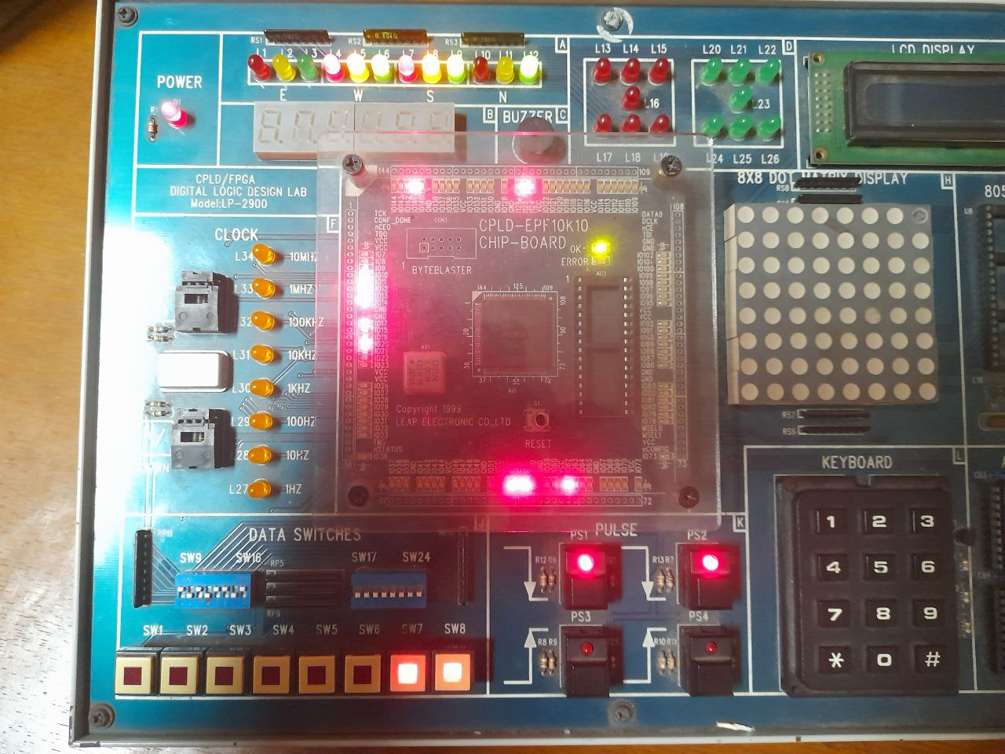
Receiver Output
Bit 5 (1)

Slide 44
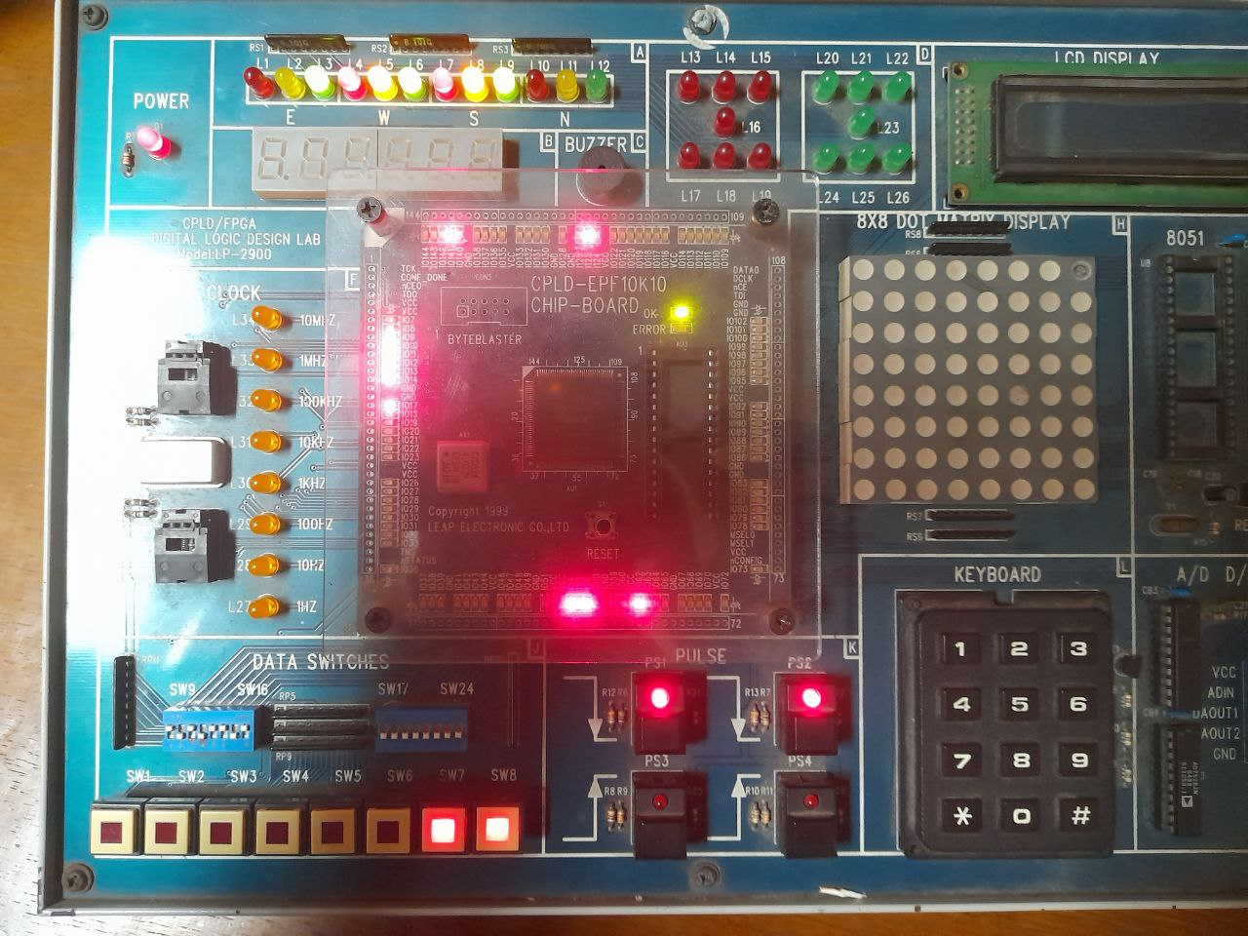
Receiver Output
Bit 6 (1)

Slide 45
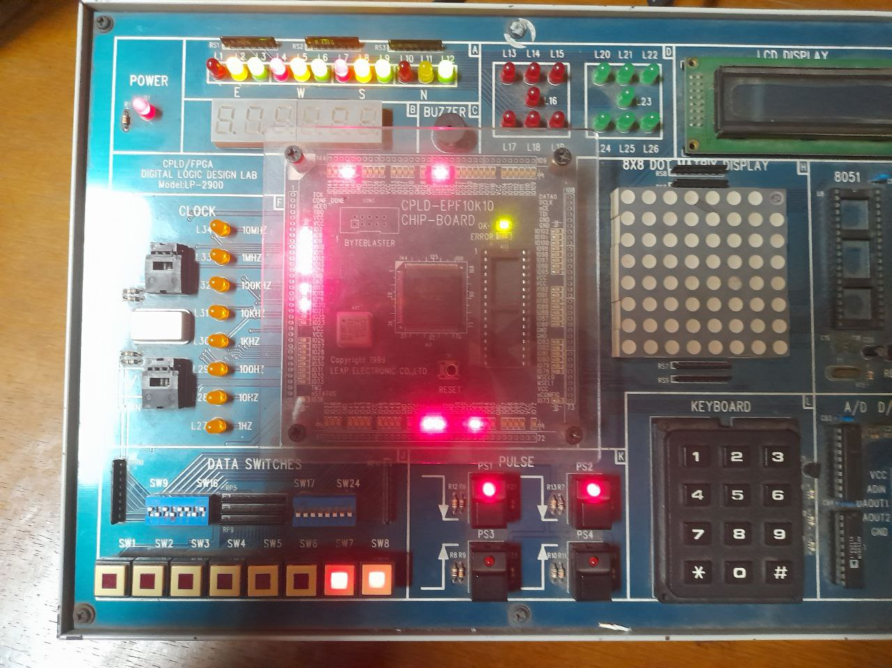
Receiver Output
Bit 7 (1)

Slide 46
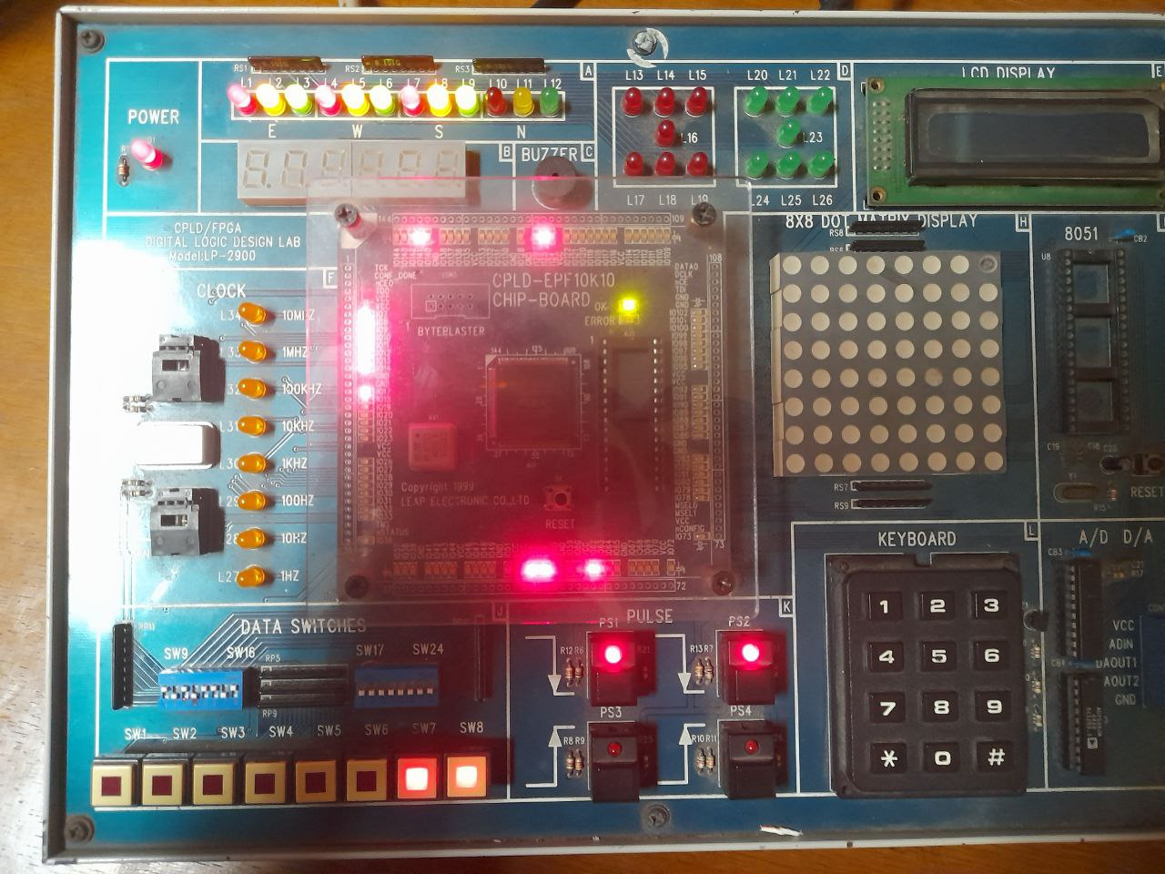
Receiver Output
Bit 8 (1)

Slide 47
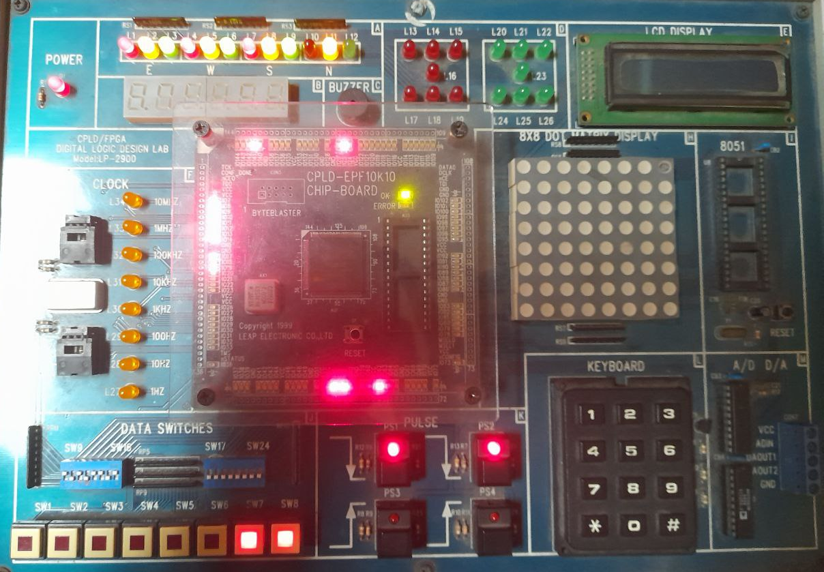
Receiver Output
Parity Bit 1 (wrong) For 11111111,
Parity is 0
Hence, Error Bit = 1

Slide 48
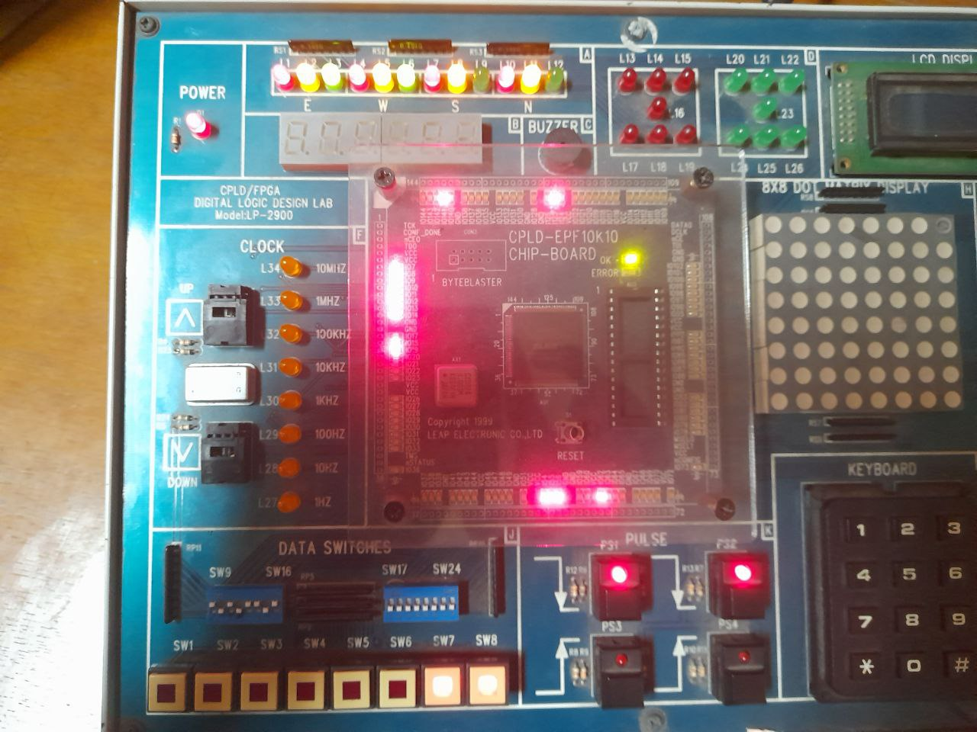
Receiver Output
Stop Bit (1)

Slide 49
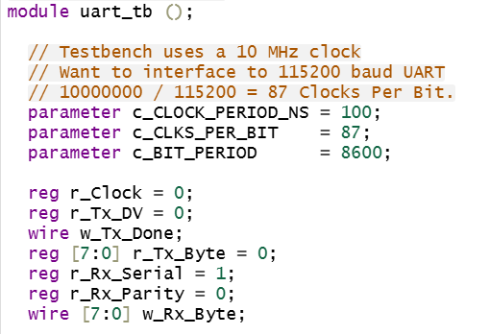
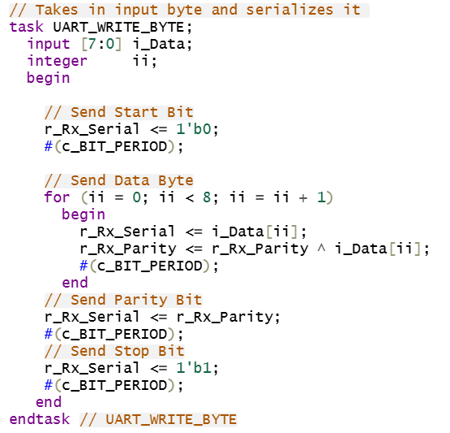
Testbench

Slide 50
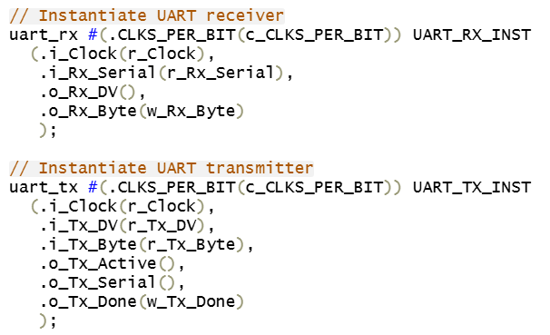
Testbench

Slide 51
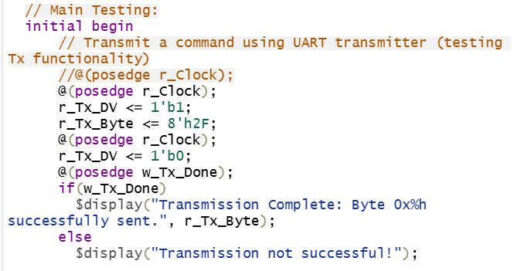
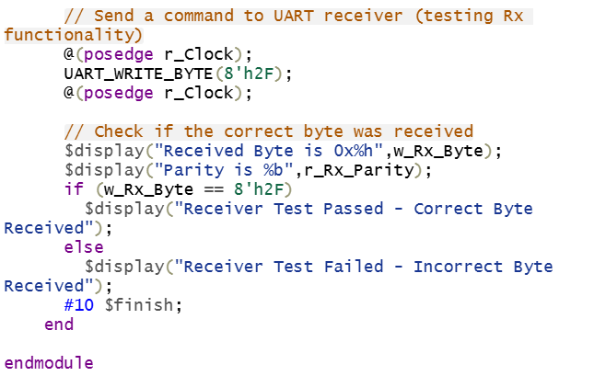
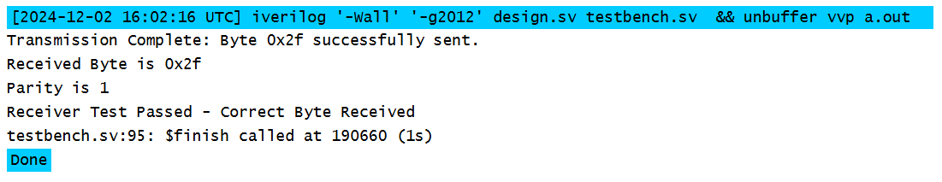
Testbench

Slide 52
Credits
Special thanks to Dr. Sajid Muhaimin Chowdhury for lecture slides and insights
EEE 304 Group_No: B1_05

Slide 53
References
https://www.elprocus.com/basics-of-uart-communication-block-diagram-applications/
https://nandland.com/uart-serial-port-module/
https://electronoobs.com/eng_circuitos_tut26_code1.php
EEE 304 Group_No: B1_05

Slide 54
Thank You
Any Query?
EEE 304 Group_No: B1_05

